Slide 1
IOT SYSTEM TO INCREASE THE AGRICULTURAL YIELD
Using LoRa

Slide 2
PROBLEM STATEMENT
There are many factors that contribute to the yield of crops, Some problems are:
Inadequate or prolonged distribution of rainfall.
Uneven maintenance of soil moisture content or soil water content.
Prolonged dry spells during the crop period.
Watering the crops with unpurified blobs of water this include Hard Water, Chlorinated Water, Toxic waters that causes the crops to die.
Over Ripening of the harvested crop due to low attention.
Over Spraying of the Chemical Fertilizers than the prescribed limit.
These all Factors contribute to the low yield of huge lands because of unattended care for every single crop in a lot.

Slide 3
OBJECTIVE
Our main aim of this project is to improve the crops yield by continuously receiving and monitoring the sensors data transmitted from the local node cluster of crops onto a centralized cloud mechanism for computation and adjusting the surrounding parameters of crops to suit the nature of plant it possesses.

Slide 4
TO ACHIEVE THIS WE NEED
A crop local node that collects the yield dependence parameters like soil water content, soil temperature, turbidity of water, hardness of water, toxicity of the water, and humidity of the air around the plants. Then the collected data is to be transmitted for computation. The feedback recieved from the central node are to be performed at the cluster nodes with the help of electromechanical devices like water flow controller, water retention controller, pesticide spray mechanisms are also to be equipped in the local cluster.
A central cloud computation node that receives the sensors’ data from individual local nodes and performs computation to best fit data at optimal values specific to the type of crop the cluster holds. This computed data is to be transmitted for proper execution at local node side.

Slide 5
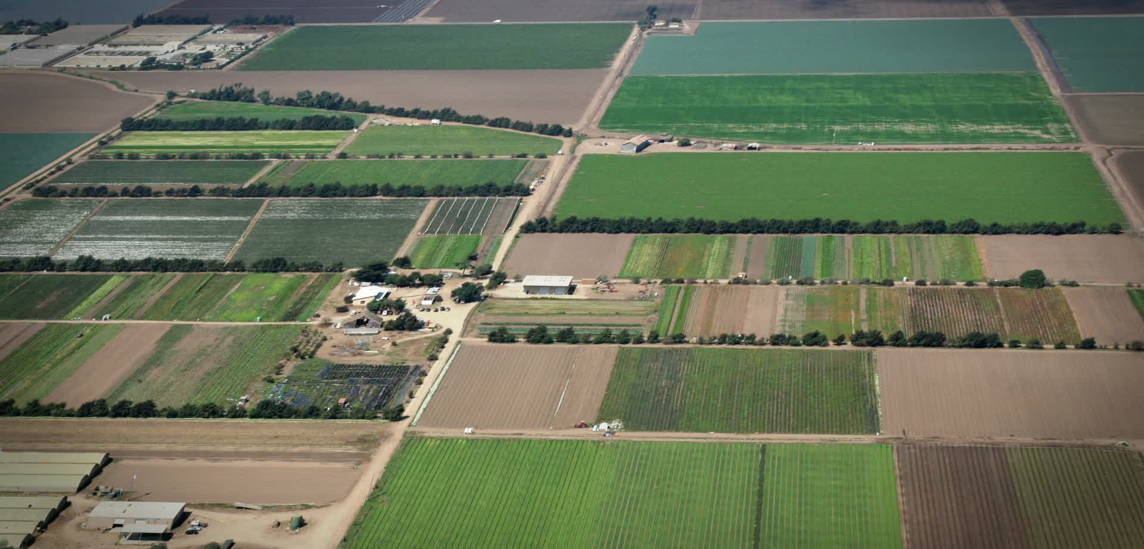
ARIEL VIEW OF IMPLEMENTATION
Local Node-4
Local Node-1
Central Node
Local Node-2
Local node-5
Local Node-3

Slide 6
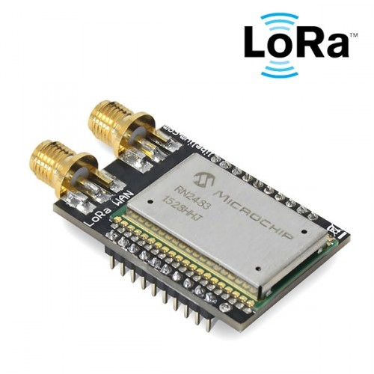
LORA FOR LONG RANGE, LOW POWER COMMUNICATION
As seen in the picture, the range of communication for huge fields is very large(upto 10-15sqKms). This can be solved using LoRa(Long Range communication module) with low power working making best fit for this application.
Key Features of LoRa
Long Range -> 15-25KM of Range to Transmit Data.
Low Power -> Can run on solar cells charging for days.
Geolocation-> Enables tracking without GPS or additional power usage.
Secure -> AES-128 encryption of data to ensure optimal privacy.
Low-Cost -> Relatively low cost when plotted against the range.

Slide 7
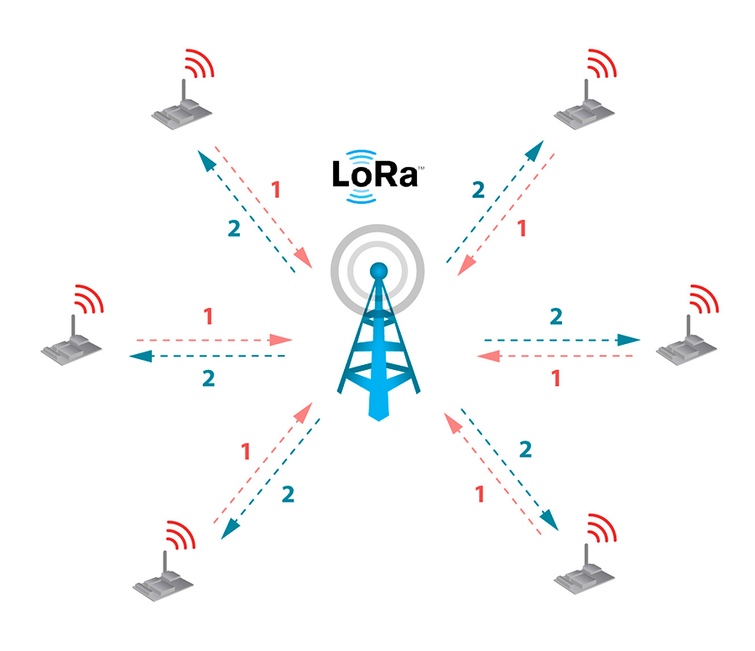
LORAWAN PROTOCOL:
This can be implemented onto a closed network by utilizing the Wide Area Network capability of the LoRa, Namely LoRaWAN Protocol.
It creates a Long Range Wide Area Network
where the data can be transmitted
to central node that is miles away with
secured(128 AES encrypted) data packets
and receive back the feedback with nearly
‘0’ noise induced in the path.

Slide 8
DATA FLOW AT LOCAL NODES
The data taken from the sensors are collected and concatenated as a single sequence of bytes of data that can be truncated at the receiving end.
The data collected will be transmitted to the central node for analysis of data to obtain the feedback of individual clusters for correction
At this step the LoRa will be set to reception mode and will receive the feedback in the same concatenated byte format and truncates the data if the feedback is present else, again sets itself into the transmission mode with a delay in collection of data.
Collecting the Data
Transmiting the Data
Reception of Feedback

Slide 9
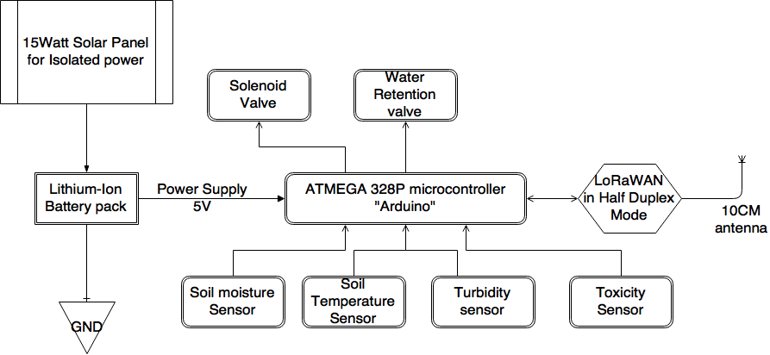
BLOCK DIAGRAM OF LOCAL NODE

Slide 10
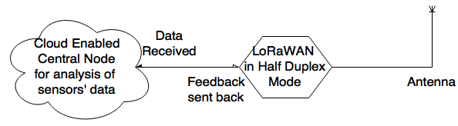
BLOCK DIAGRAM OF GATEWAY
Recieving Data Continuously from local nodes
Performing computation to determine the irregular patterns
Sending back the correction commands to the local nodes

Slide 11
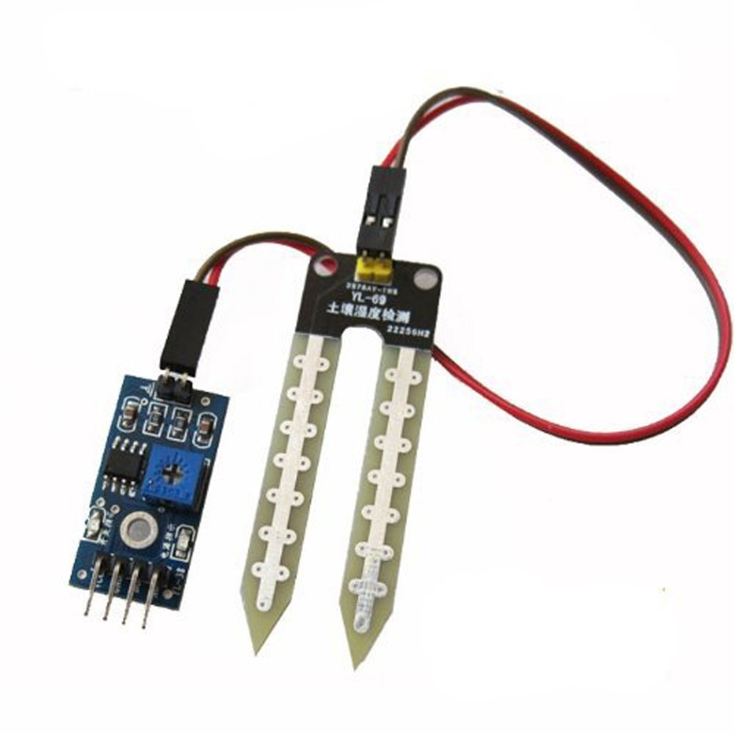
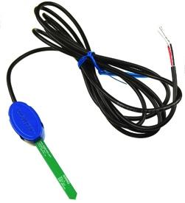
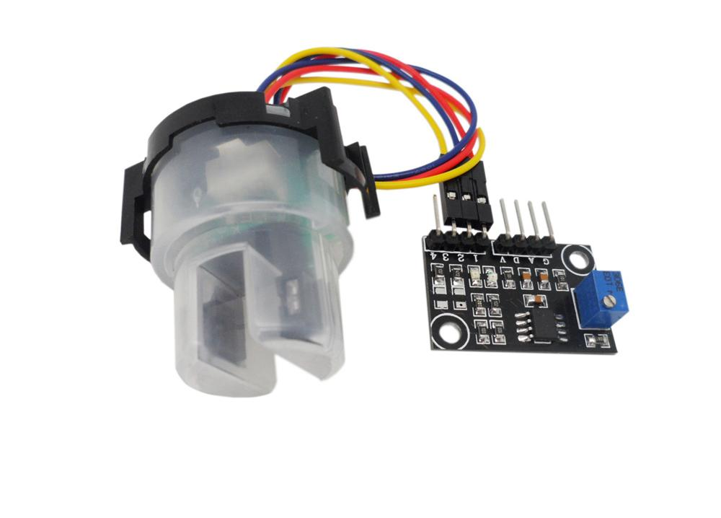
SENSORS AT LOCAL NODE
Sensor | Description | Image
1.Soil moisture sensor or Soil water content Sensor | It Calculates the amount of water or moisture present in the soil by mapping it to the resistance between the two probes by passing a constant current from the R=V/I equation. Vop=3.5-5.0V Data=> Vout=2.0V->100% water =4.9V-> 0% water
2. Soil Temperature Sensor | It calculates the soil temperature by mapping the change in voltage in the Vout. 10mV/1degree. Standard is 30degrees.
3.Turbidity Sensor | It calculates the the amount of turbidity present in the water by passing a light beam through probes and calculating the amount of light reached to the other probe. Data=> Vout=5.0V-> 100% Clear =0.V-> 0% Clear

Slide 12
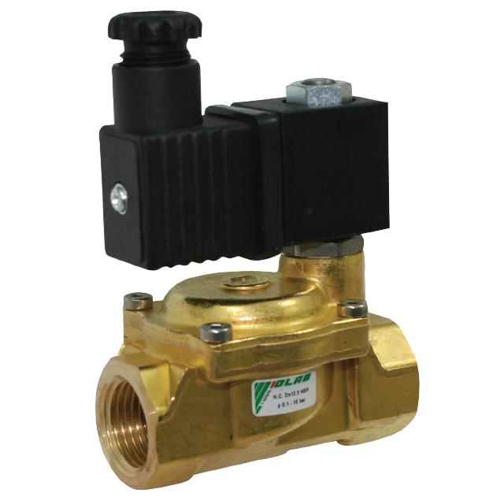
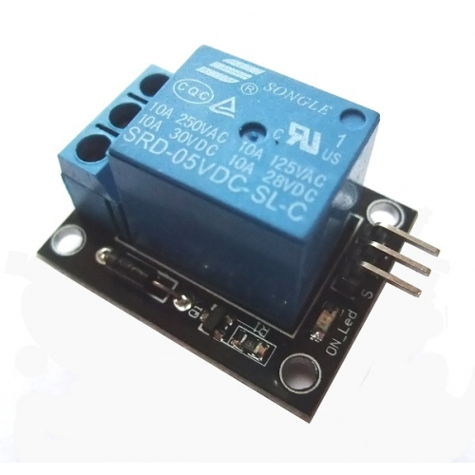
ELECTROMECHANICAL CONTROLLERS
Device | Description | Image
1.Solenoid Valve | It controls the flow of water to crops based on the solenoid swith it has. It works under the principle of electromagnetism. If the circuit is complete the switch will be opened and water flows, If the circuit is not complete then the switch will be closed and water flow is stopped.
2. Relay Switch | This is required to control the solenoid valve because the solenoid valve activates with 12V but Microcontroller can only give 5V at Max. So, A relay is introduced in the middle to interface the both. The same solenoid principle applies here But with a small coil.

Slide 13
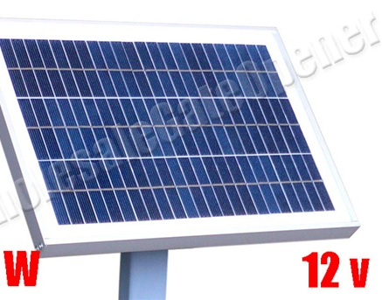
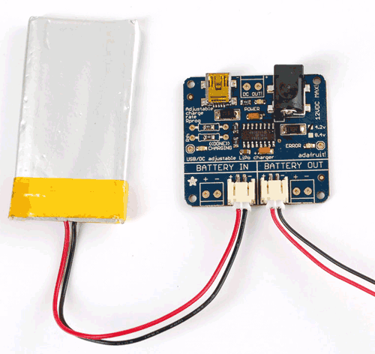
POWER SOURCE AND STORAGE
Component | Description | Image
1.Solar Panel 24W | To Make this entire setup truly isolated in terms of the central node the power is generated from the solar energy day time and utilised ini the night from a battery. A 24W 12V solar panel can be used here to supply the 12V solenoid valve as wel.
2. Lithium Ion Battery | The solar energy gathered from the solar panel is stored into a 5V lithium ion battery for cloudy or night time usage of the entire circuit without interruption. Vin=12V ; I=2A from Solar panel Vout=5V 2A regulated supply

Slide 14
SUMMARY
This system will help in increasing the productivity of the crops from getting the real-time sensors data and applying the sophisticated analysis tools to get a perfect feedback for certain variety of plants that require more attention and care.
The system being utilised with LoRa has a wide range of applications for the transmission and reception of data, with a long range of 22KM with Line Of Sight and 2.5KM of No Line Of Sight. This helps in the collection, transmission, applying feedback of data more quickly using the cloud computing technology and data analytics tools.
This setup will be very secured because the LoRaWAN has 128AES encryption for the transmiting data.

Slide 15
THANK YOU

Slide 16
Thank You
Guide: Dr. L.L. Rajeswara Rao,
M.Tech, Ph.D, IISc Bangalore,
EIE Dept.,GIT.
Members: Abhishek Yanamandra (1210414361)
Bhamidipati Manaswini (1210414307)
Pemmaraju Sai Ravi Teja (1210414336)
Varanasi Rohit Kumar (1210414366)
Narnam Sai Maheedhar (1210414334)

